Slide 1
NAPLAN Practice Time
Clem Evans
Week 1 Term 2

Slide 2
Why do I need to do NAPLAN?
NAPLAN is the measure through which governments, education authorities, schools, teachers and parents can determine whether or not young Australians have the literacy and numeracy skills that provide the critical foundation for other learning and for their productive and rewarding participation in the community.
The tests provide parents and schools with an understanding of how individual students are performing at the time of the tests. They also provide schools, states and territories with information about how education programs are working and which areas need to be prioritised for improvement.
NAPLAN tests are one aspect of each school’s assessment and reporting process, and do not replace the extensive, ongoing assessments made by teachers about each student’s performance.

Slide 3
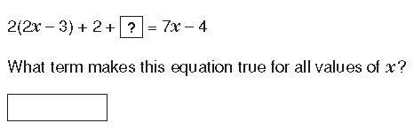
How could we solve this problem?
Talk to your partner and come up with a strategy.
Suggestions:
Notes:
Use the questions as prompts to get students to discuss what information is needed to answer the question. Then discuss strategies that may be used (if wrong strategies are suggested, follow them through to show how they will turn out and give students opportunities to change their minds) and model how to complete the problem.
Students should take notes on how to perform each function and use them when completing their practice tests.

Slide 4

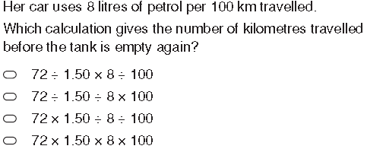
How could we solve this problem?
Suggestions:

Slide 5
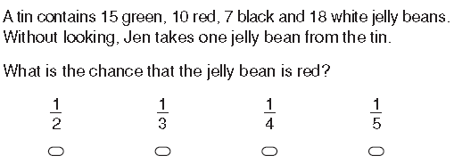
How could we solve this problem?
What information do we need from the question?
Suggestions:

Slide 6
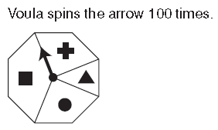
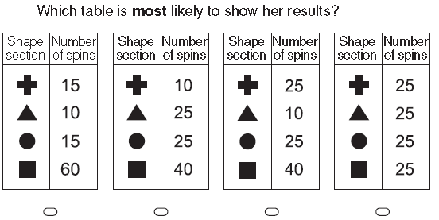
How could we solve this problem?
Suggestions:

Slide 7
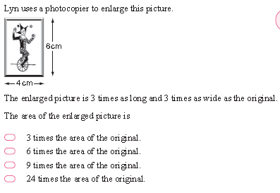
How could we solve this problem?
Try it yourself and be prepared to share your strategies.
Suggestions:

Slide 8
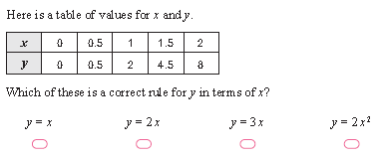
How could we solve this problem?
Suggestions:

Slide 9
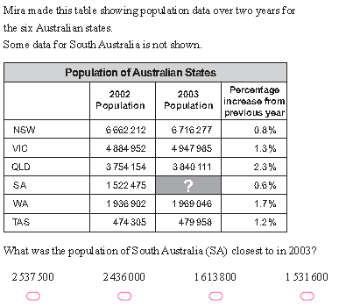
How could we solve this problem?
Write down how you increase a number by a %.
Suggestions:

Slide 10
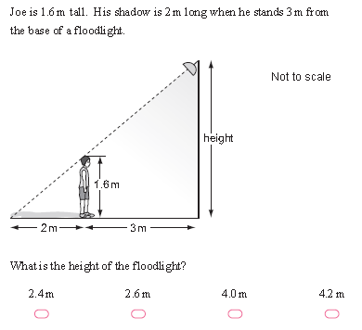
How could we solve this problem?
Suggestions:
Notes:
1.6:2
X:5
2/1.6=1.25 therefore
X multiplied by 1.25=4
X=4

Slide 11
Use your notes from today when you complete your NAPLAN Practice test tomorrow.
Notes:
Independent practice will take the form of the NAPLAN Practice test which should be completed in pairs.

